Slide 1

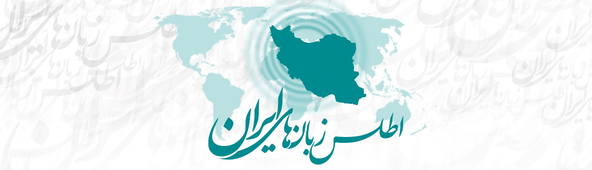
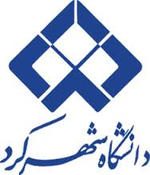
NACIL 2017 Stony Brook
Salient Linguistic Features and Isoglosses in Chahar Mahal va Bakhtiari Province, Iran
Mortaza Taheri-Ardali, Shahrekord University

Slide 2
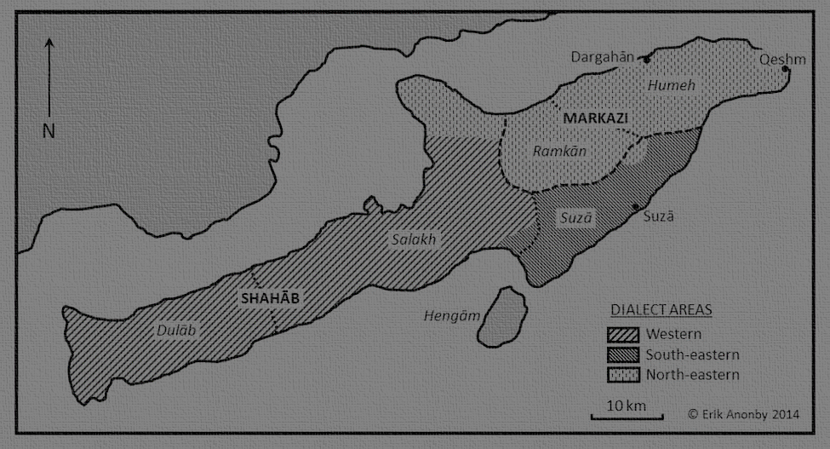
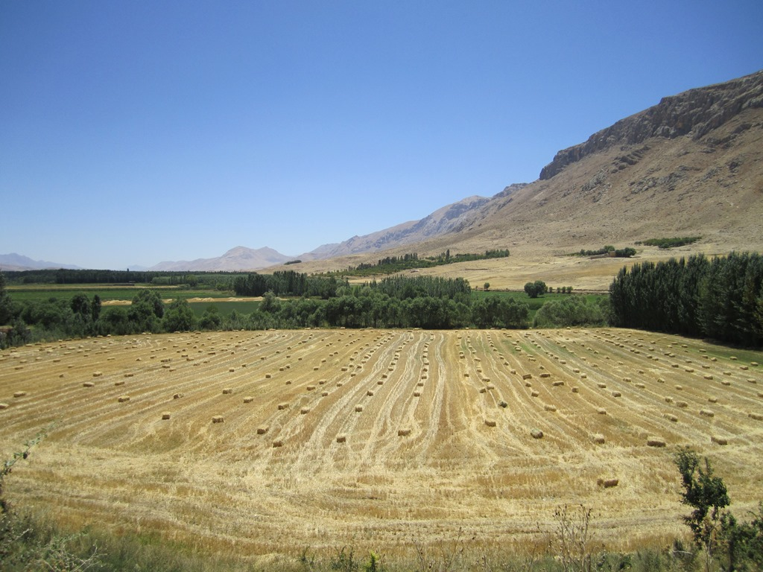
Structure of this paper
Questionnaires and data collection
Research sites and how we chose them
Distinctive features of certain languages and isoglosses/boundaries between them
Linguistic diversity
Language contact
Conclusion

Slide 3
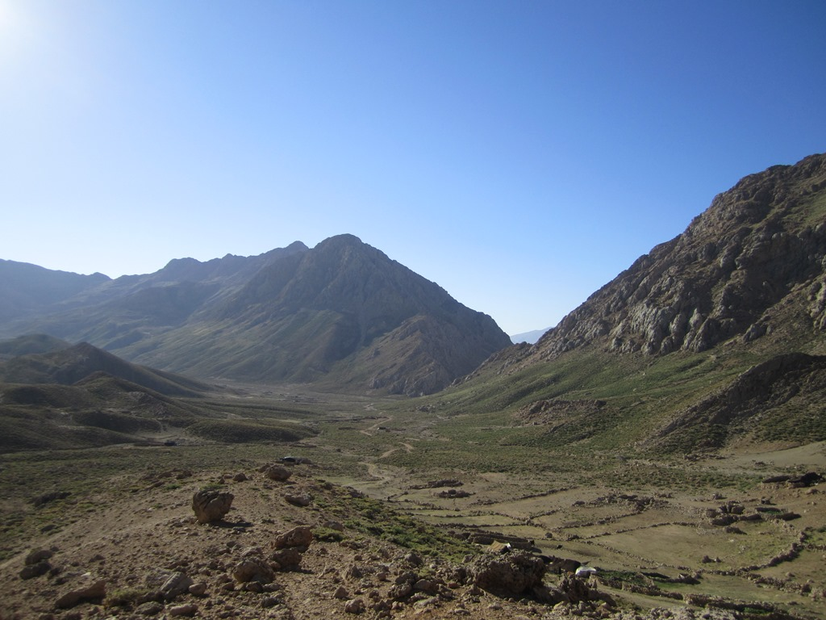
Research methodology
Questionnaires and data collection
  a 5-part standardized questionnaire
    Sociolinguistic setting of each research site; lexicon; phonology
    Grammar
    Numerical system
  Recordings

Slide 4
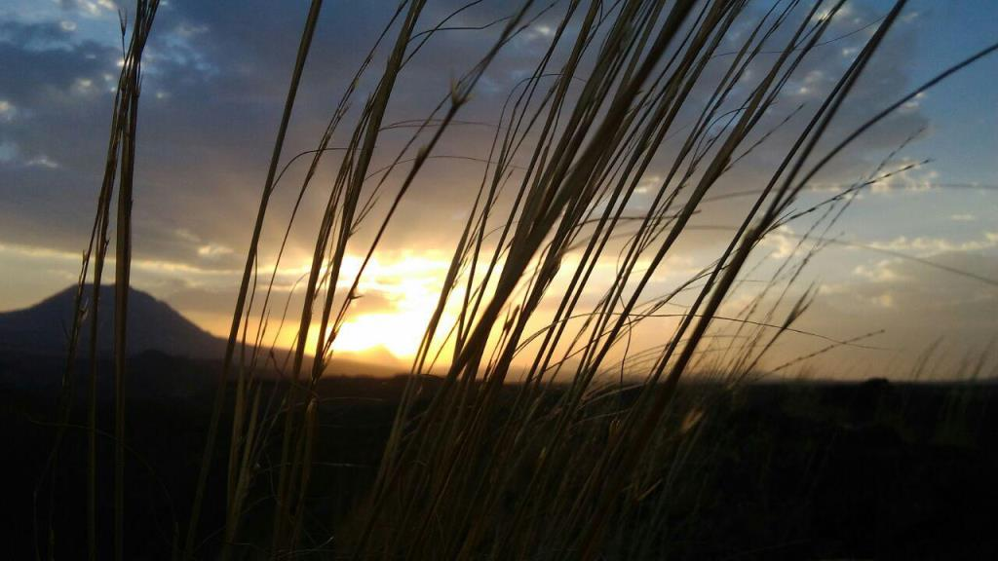
Research site selection
language data for each dialect, from one site in each shahrestan
covering most linguistic diversity in each shahrestan
bilingual or multilingual settlements
35 locations
  25 of these 35 sites done so far

Slide 5
Distinctive features and isoglosses/boundaries
Softened d [ð̞] (called “Zagros d” by Windfuhr 1998 & Anonby 2014)
Bakhtiari of Sar Aqa Seyyed
  Historical d has shifted to r [ɾ]
    xorā ‘God’, čameraʋn ‘suitcase’, esbir ‘white’, dir ‘he/she saw’
ɢ and q
  ɢāli ‘carpet’ vs ɢāšoɢ ‘spoon’

Slide 6
Distinctive features and isoglosses/boundaries
Absence of glottal stop
  mehde ‘stomach’
Superlative marker
  huʋe gaftare ~ huʋe gaftartare ‘the biggest house’.
Fronting of u
  pul > pil ‘money’; pulaki > pilaki ‘candy’ and kuče > kiče ‘alley’, bud > bid ‘was’.

Slide 7
Linguistic diversity
u [u] vs ü [y]
  dü ‘smoke’ and du ‘yoghourt drink’
The plural marker
  -(h)ā, hune + ha > hunehā ‘house’
  -al/gal/yal
  bače + -yal > bačiyal ‘children’, boz + yal > bozyal ‘goats’
  ɢand + -al > ɢandal ‘sugar cubes’

Slide 8
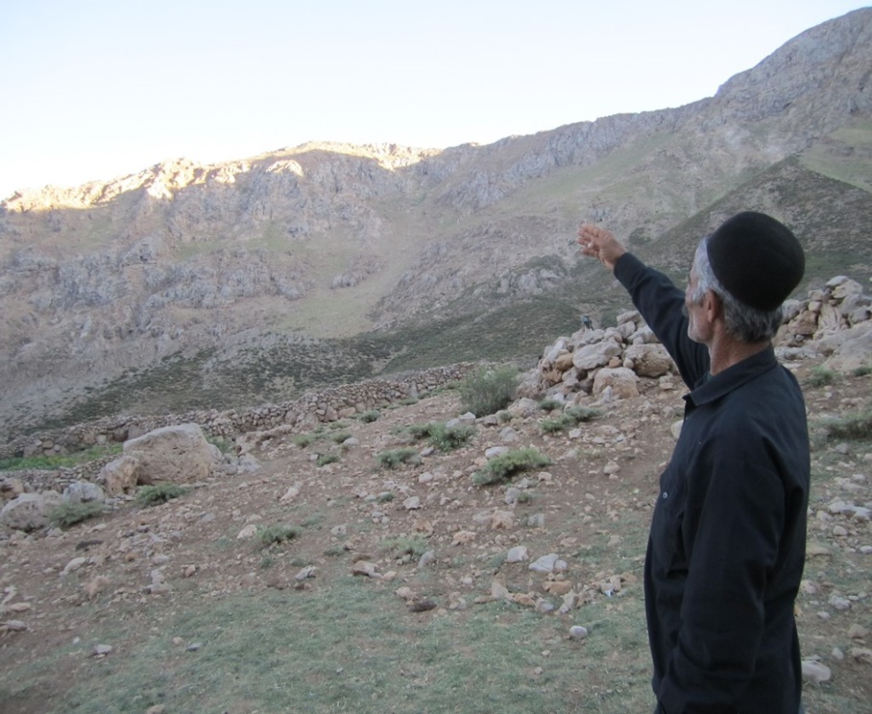
Linguistic diversity
s VS š
  zeydes vs zeydeš, ‘He hit him/her’
  zeydesun vs zeydešun, ‘He hit them’
  ketāves vs ketāveš, ‘his/her book’
  ketāvāsun vs ketāvašun, ‘their books’
  xos vs xoš ‘himself herself’
  xosun vs xošun ‘themselves’

Slide 9
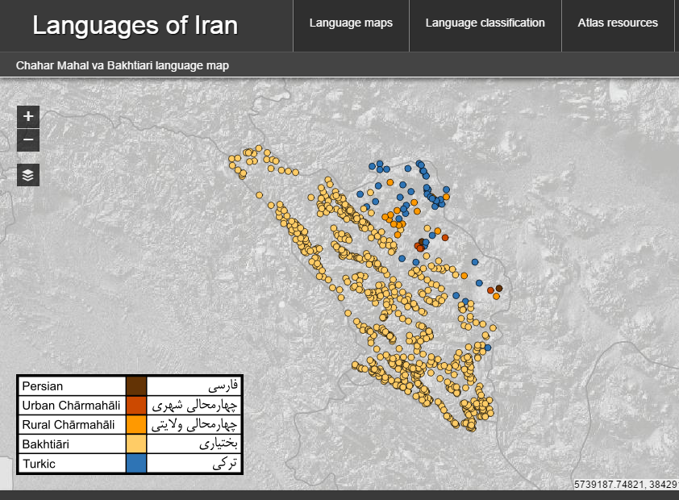

Slide 10
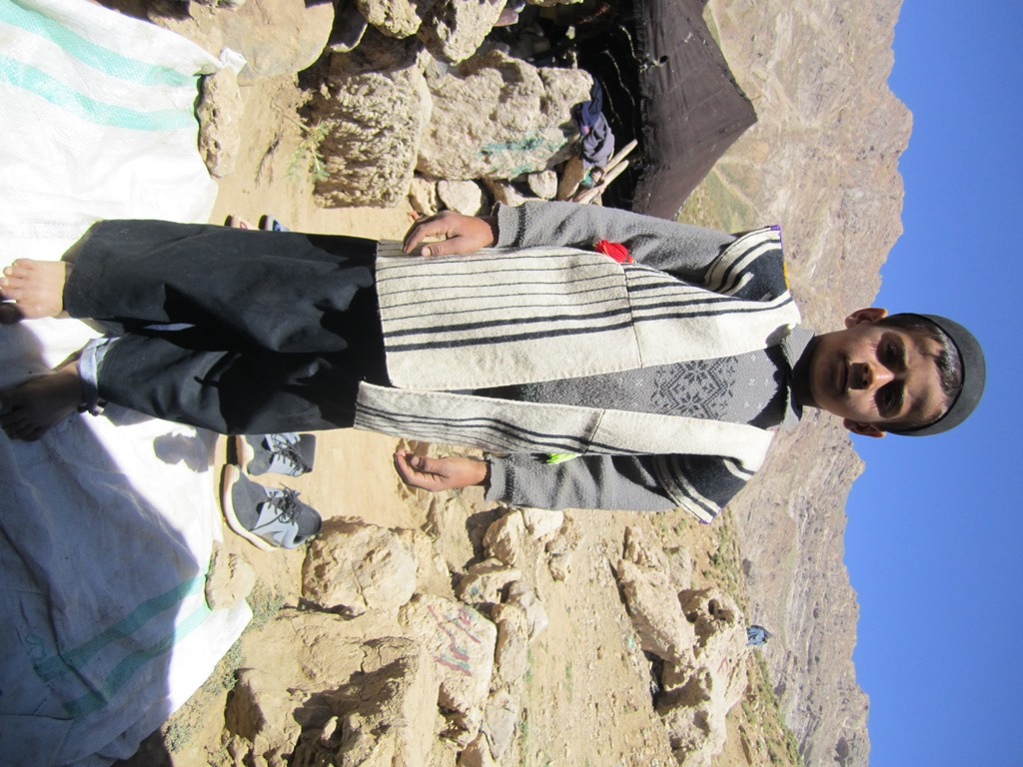
Diphthongs and diphthong-like vowels
The word ‘new’:
  naw in Bakhtiari of Dinaran
  now in Bakhtiari of Ardal
  no in Urban Charmahali of Shahr-e Kord
The word ‘fever’:
  taw in Bakhtiari of Dinaran
  tow in Bakhtiari of Ardal
  tab in Urban Charmahali of Shahr-e Kord

Slide 11
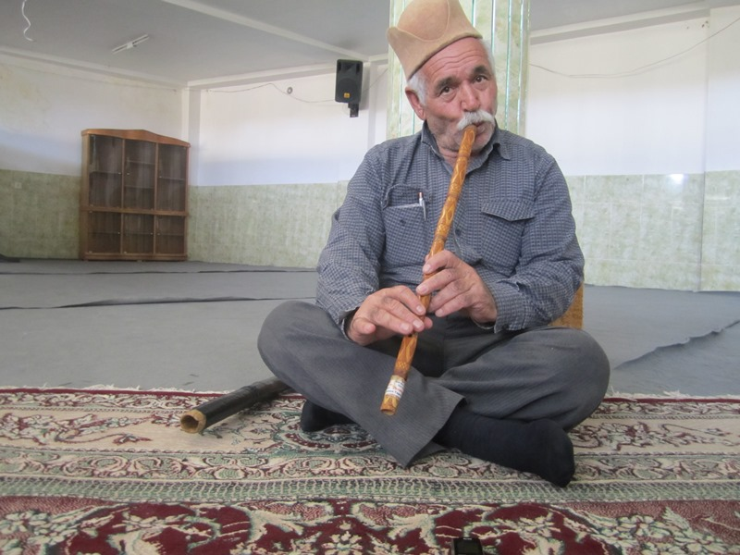
Language contact
The impact of Bakhtiari and Persian on Turkic of Boldaji
  Only a vestige of the vowels ü [y], ö [œ] and ı [ɨ]
  Simpler Iranic-type six vowel system

Slide 12
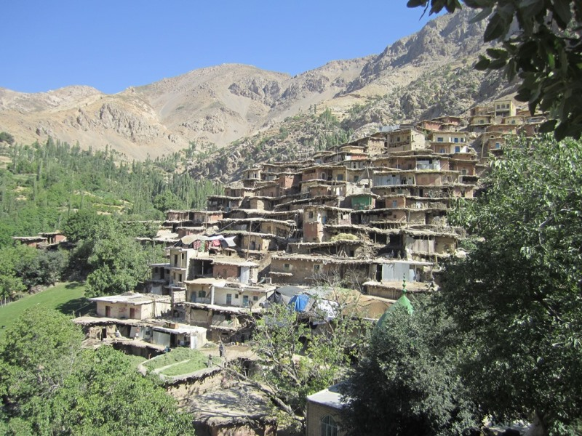
Conclusion
more investigation of the linguistic features at morphosyntax based on texts
Charmahali types
constant changes in administrative divisions

Slide 13
Thank you!

Slide 14
References
Anonby, Erik., & Asadi, Ashraf. 2014. Bakhtiari Studies. Phonology, Text, Lexicon. Acta Universitatis Upsaliensis. Studia Iranica Upsaliensia 24. 222 pp. Uppsala. ISBN 978-91-554-9094-2.
Anonby, Erik. et al. (eds.) 2016. Atlas of the Languages of Iran. Ottawa: Geomatics and Cartographic Research Centre. Available at: http://iranatlas.net.
Schreiber, Laurentia, Mortaza Taheri-Ardali, Geoffrey Haig and Erik Anonby. 2017. Contact-induced change in Irano-Turkic morphosyntax. Conference on Language Contact and Language Change in Western Asia, Goethe University Frankfurt, 10-12 March, 2017.
ISC (Iran Statistics Center). (2011). Sarshomāri-ye omumi-ye nafus o maskan 1390 [Public census of population and settlement 2011]. Tehran: Ministry of the Interior,Iranian Statistics Center.
Taheri-Ardali, Mortaza. et al. 2016. Chahar Mahal va Bakhtiari Province. In: Anonby, Erik et al. (eds.), Atlas of the Languages of Iran. Ottawa: Geomatics and Cartographic Research Centre. Available at: http://iranatlas.net/index.html?module=module.language-distribution.chahar_mahal_va_bakhtiari#.
Eidy, Reza. 1996/1375. Barresi-ye Guyesh-e Bakhtiari – Guneh-ye Ardal [The study of Bakhtiari Dialect – Ardal Variant] (MA thesis), Tehran: Tehran University.
Madadi, Zohrab. 1996/1375. Vazhehnameh-ye zaban-e Bakhtiari [Lexicon of the Bakhtiari language]. Tehran/Esfahan: Entesharat-e Ayat.
Windfuhr, Gernot. 1988. Baḵtīārī tribe: The Baḵtīārī dialect. Encyclopædia Iranica 3.5, 553–560. New York: Center for Iranian Studies, Columbia University. Online address: http://www.iranicaonline.org/articles/baktiari-tribe#pt2.

